Slide 1


Assignment on Git and Github
By: Ayush Kumar

Slide 2

Tasks
1. Create and collaborate on a new empty repository on GitHub.
2. Each member should make one commit each
3. This group needs to learn and discuss on the following topic - Rebase
4. You need to push the slides on a new empty repository on Github

Slide 3

Task 1

Slide 4
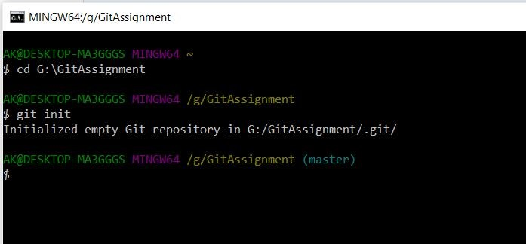
Create and collaborate on a new empty repository on GitHub.

Slide 5
Task 2

Slide 6
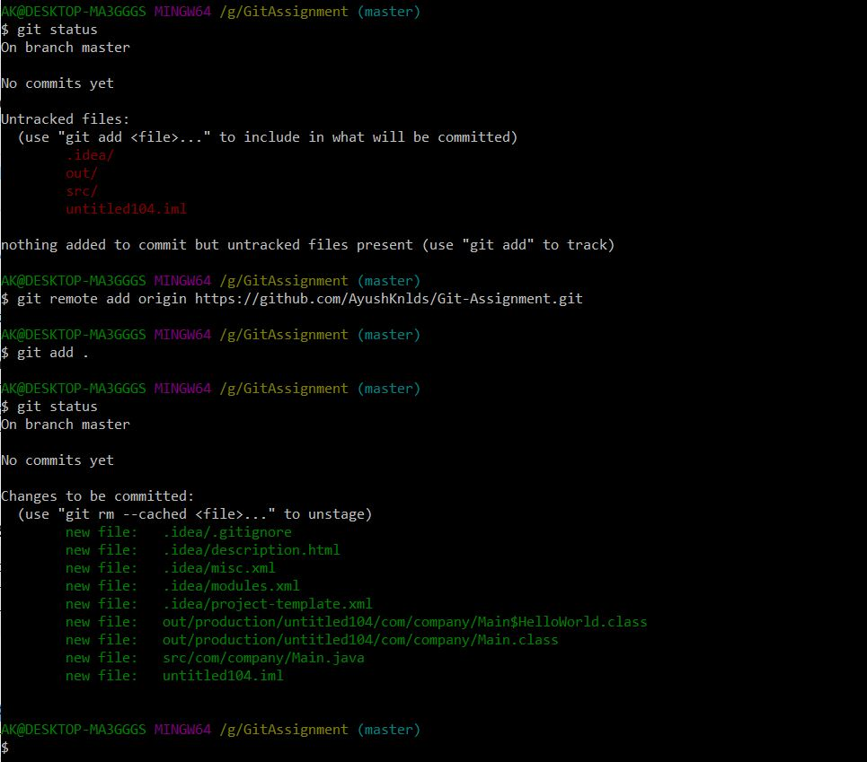
Each member should make one commit each.
Step 1 - Add files in the Git-Assignment repo

Slide 7
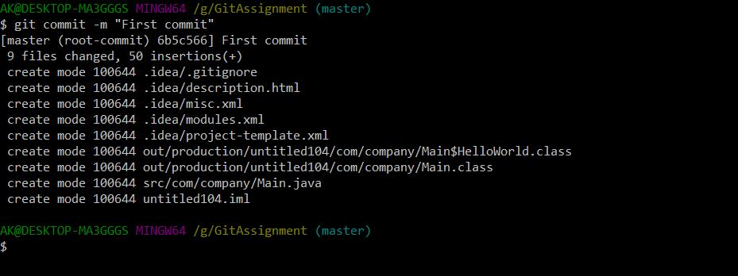
Step 2 - Use git commit for commit changes.

Slide 8
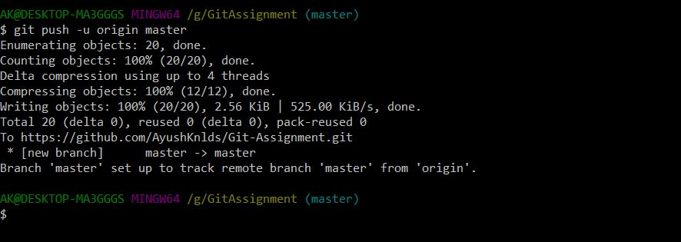
Step 3 - Push the local repo to the remote origin.

Slide 9
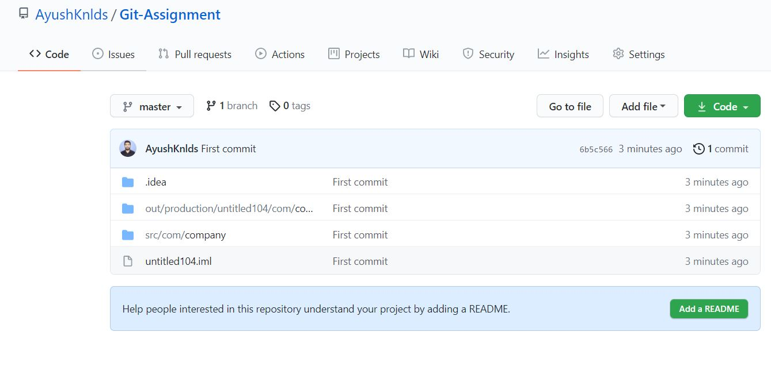
Remote repository created

Slide 10
Task 3

Slide 11
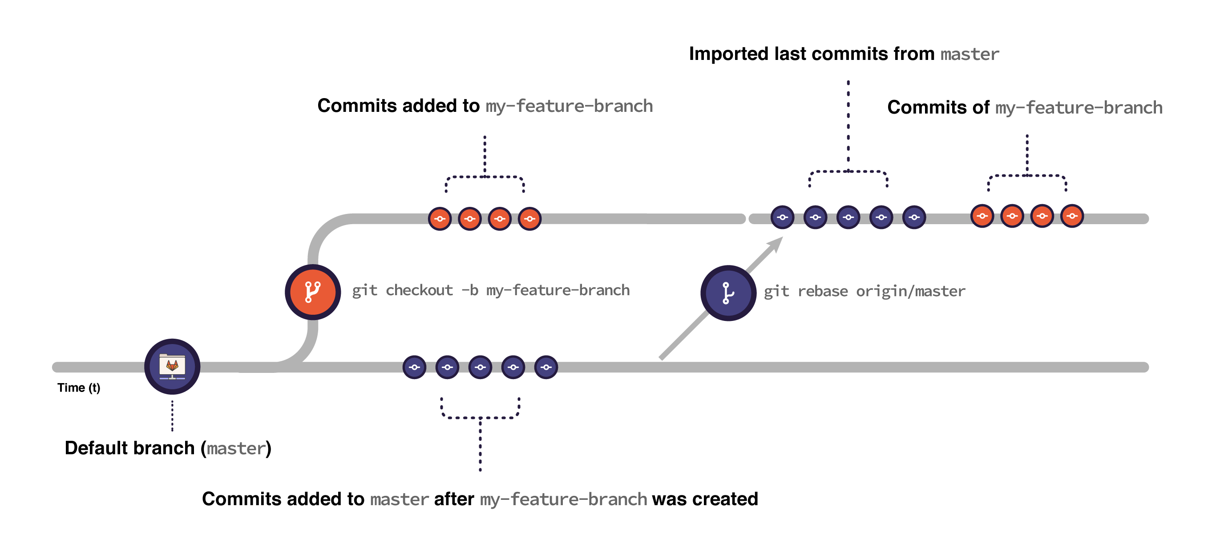
Git Rebase
A rebase is what you do when you combine a commit or series of commits to a new commit.
It is similar to merging in that it moves changes from one branch to another.

Slide 12
Rebasing allows you to rewrite the history of a Git repository. When you run a rebase operation, it merges the entire history of two branches into one. This will create brand new commits for each in another branch inside the branch you are rebasing.
Rebasing is most commonly used to integrate changes from upstream into a local repository.

Slide 13
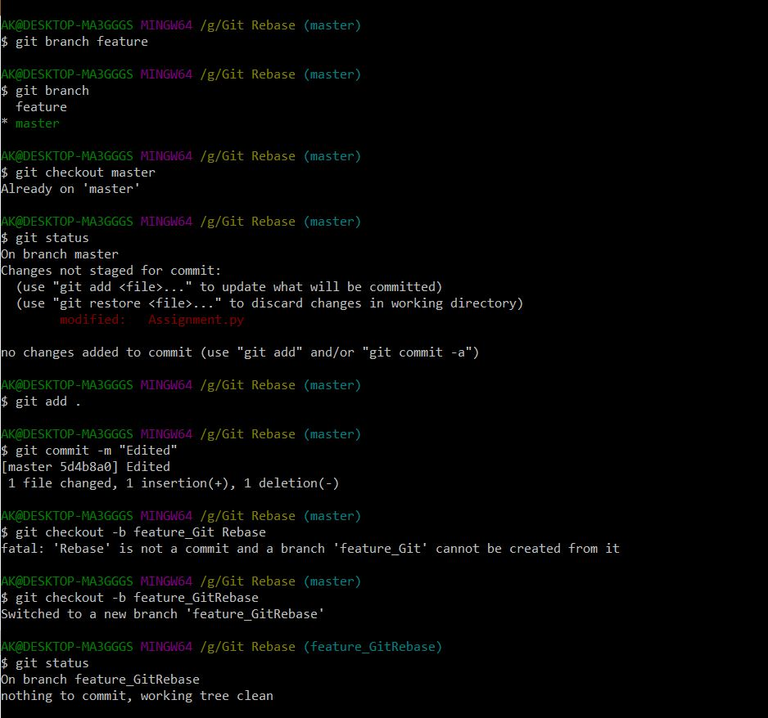
Working on feature branch and trying to merge changes on master branch

Slide 14
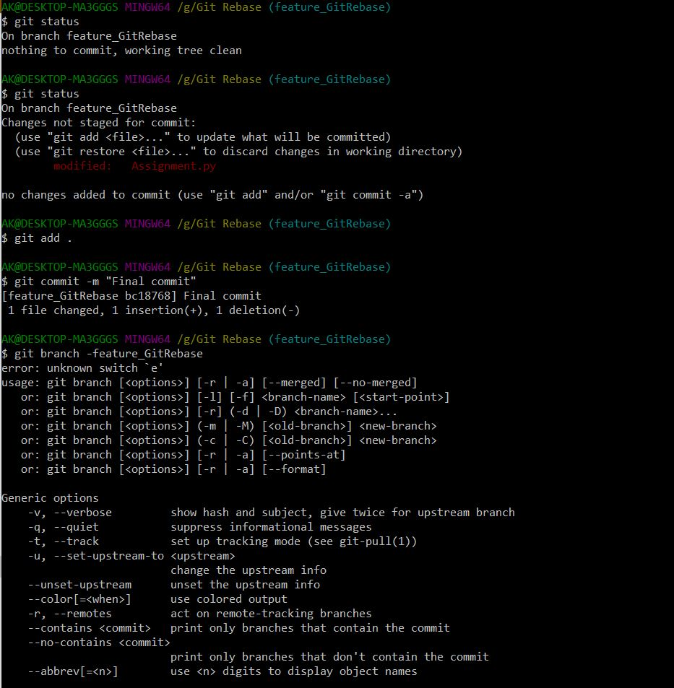
Before merging on master branch, some change are done on master branch which are not present on feature branch.

Slide 15
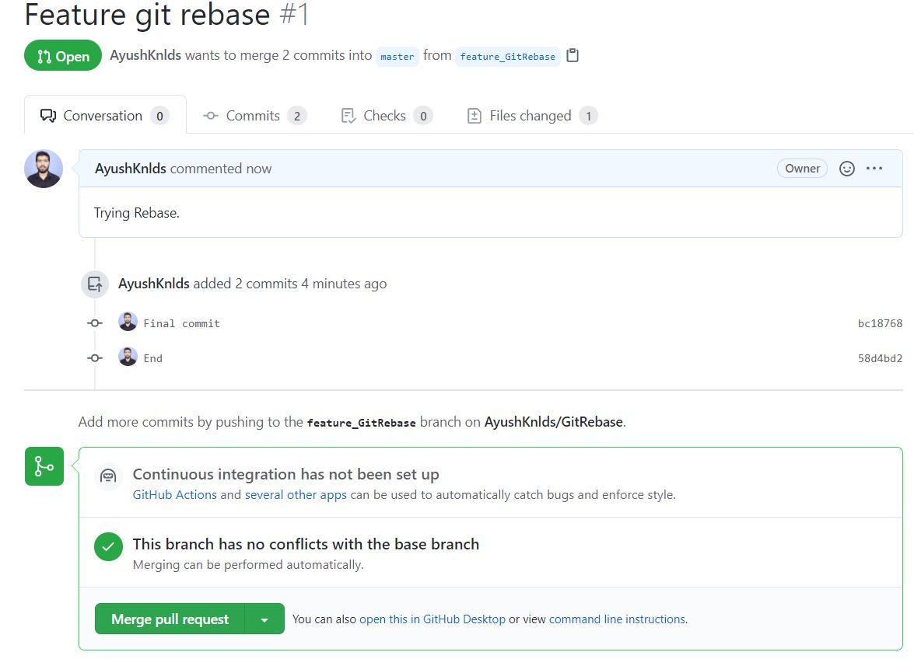
Then when we try to merge the feature branch on merge branch then conflicts are generated.

Slide 16
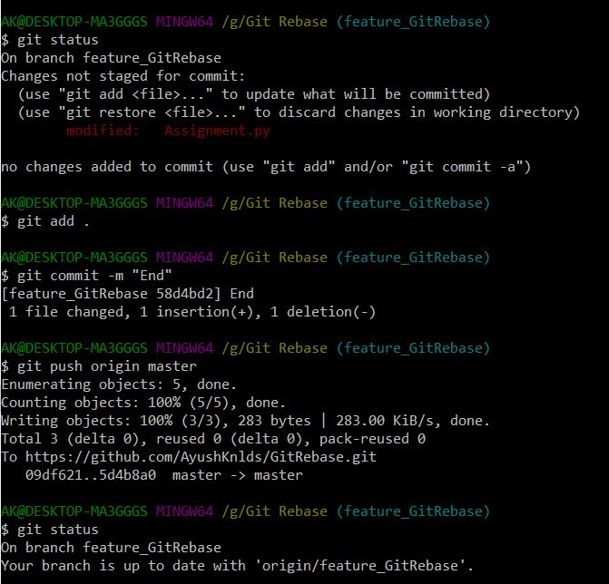
Now, performing rebasing and resolving conflicts.

Slide 17
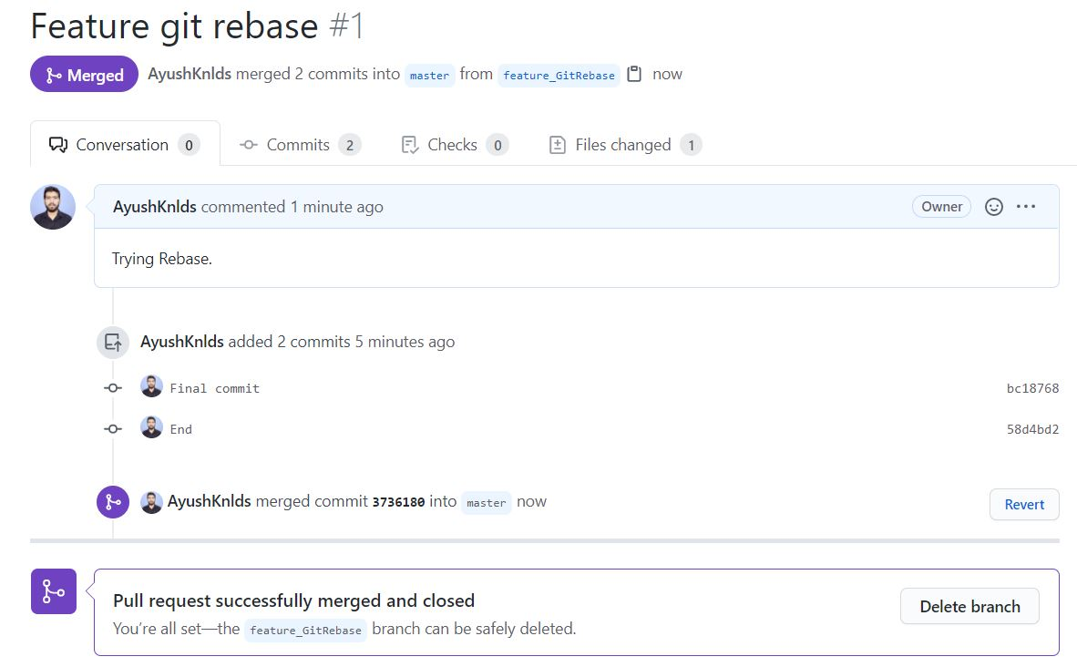
Conflicts resolve and now feature branch is merged on master branch

Slide 18
Thank You

